Slide 1
Amazon Sales Performance Dashboard 2025 – Elevate Labs
Interactive dashboard summarising Amazon sales performance 2025
Presented by:
Uzma Sultana

Slide 2
Dashboard Overview:
Purpose : To analyze and visualize Amazon sales data for 2025
Platform Used : Power BI
Scope : Revenue, cost, quantity sold, customer location, and
product performance.
Business Goal : Provide insights for sales strategy, inventory planning, and
Customer targeting.

Slide 3
Short Explanation:
section | What it Shows
KPIS | Revenue, cost, Quantity, Profit
Product performance | Bar chart of quantity sold By product
Regional sales | Sales by customers location
Order and payment insights | Pie chart showing order status and payment methods
Interactive slicers | filters for Location, Status, Payment methods

Slide 4
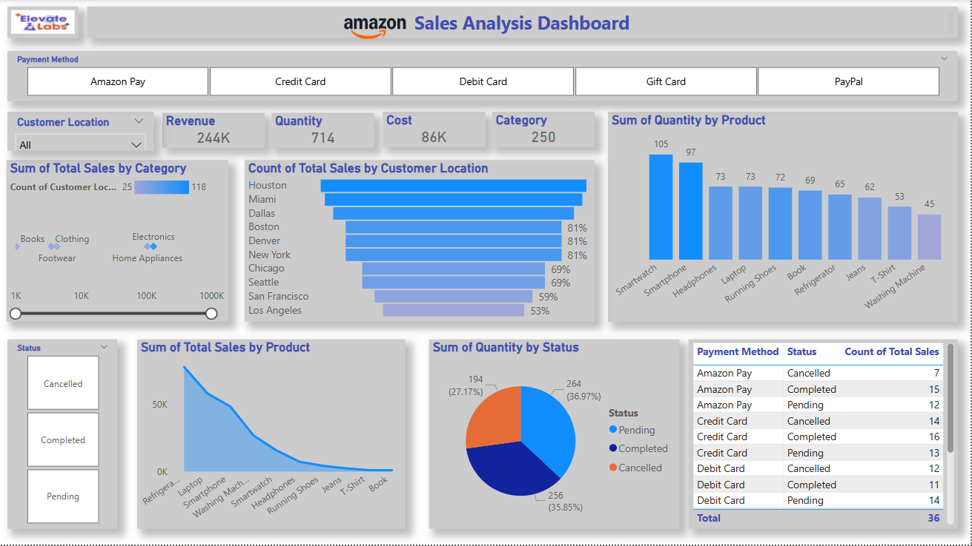
Dashboard:

Slide 5
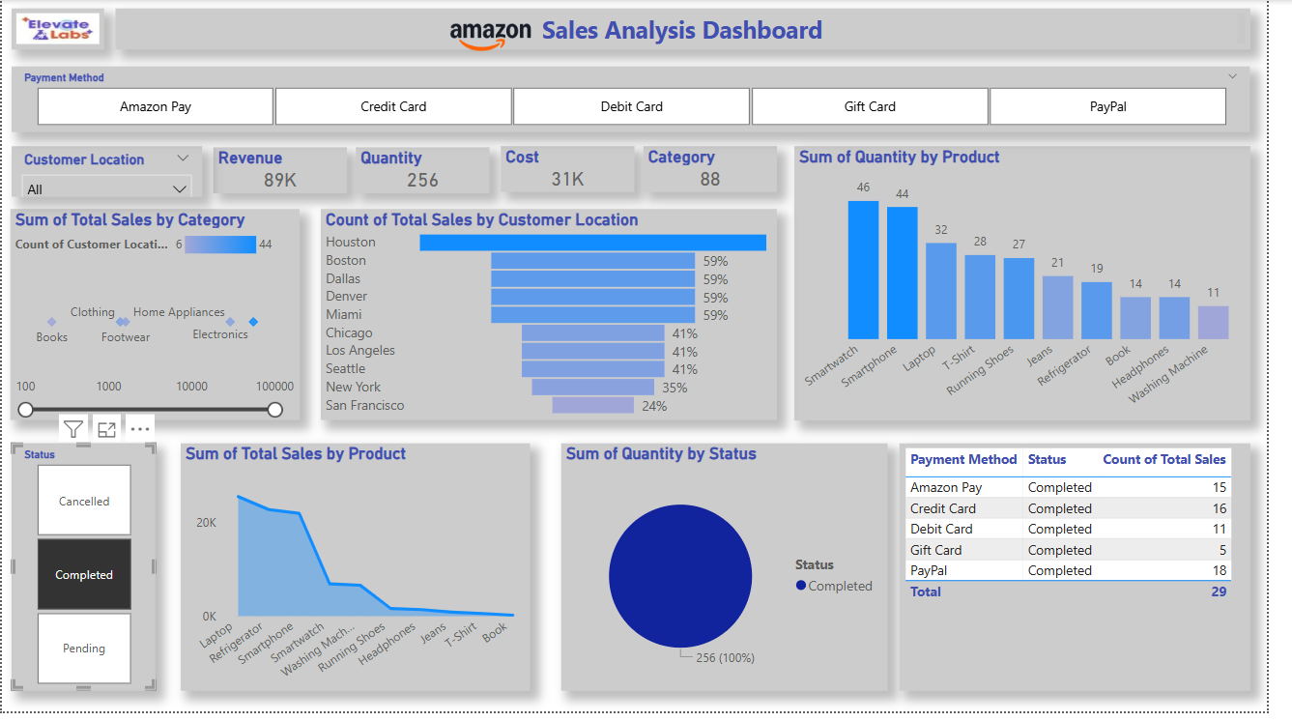
Based on status:
Completed:

Slide 6
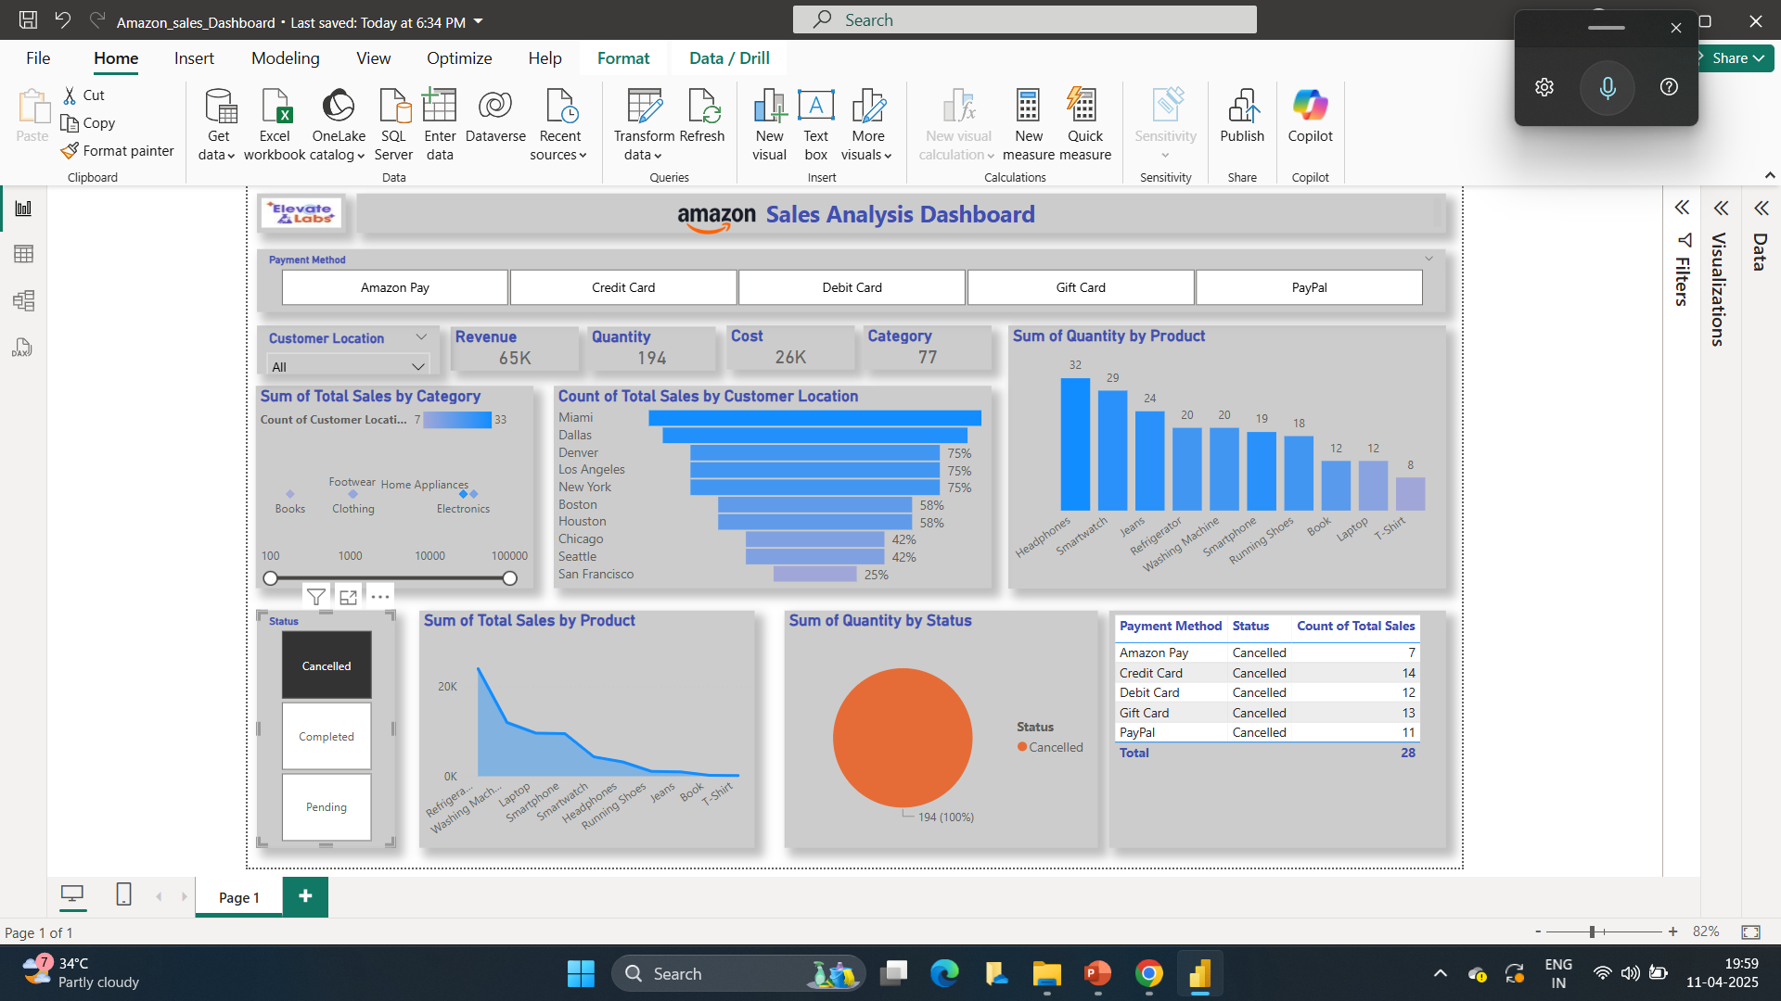
Cancelled:

Slide 7
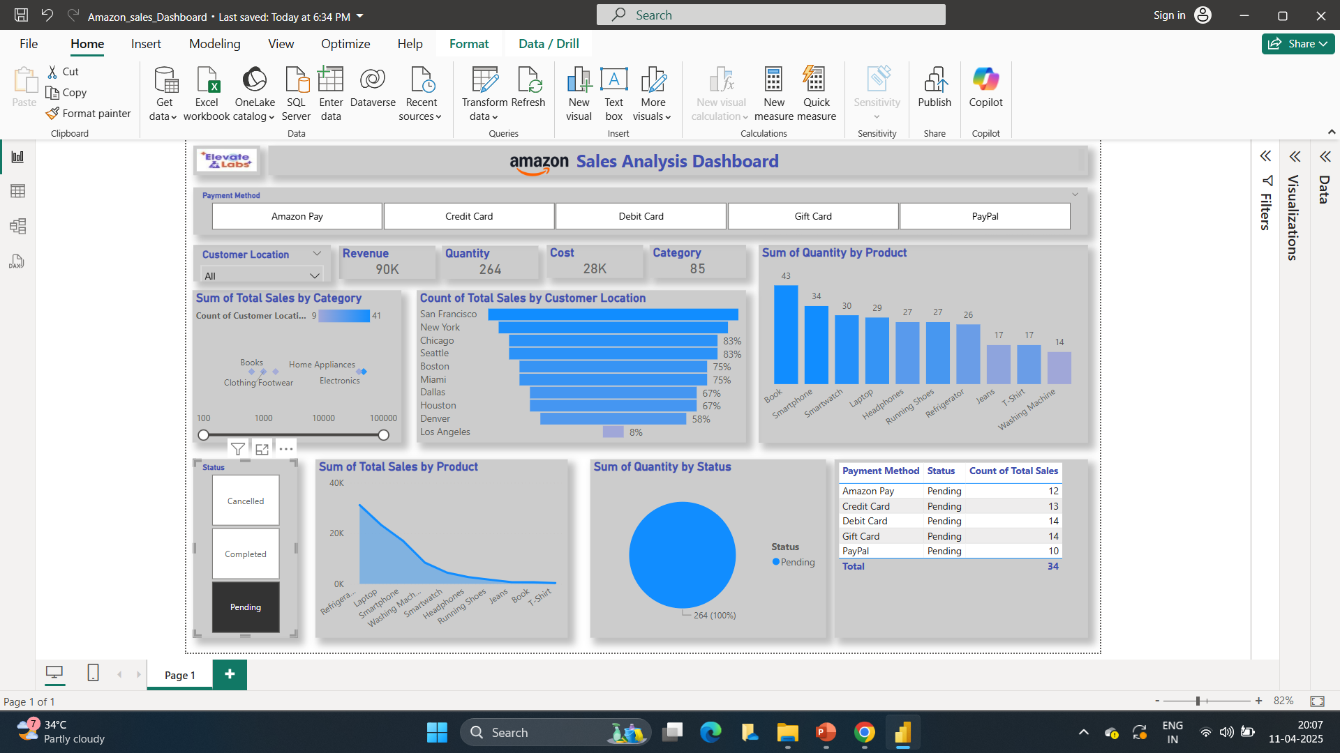
Pending:

Slide 8
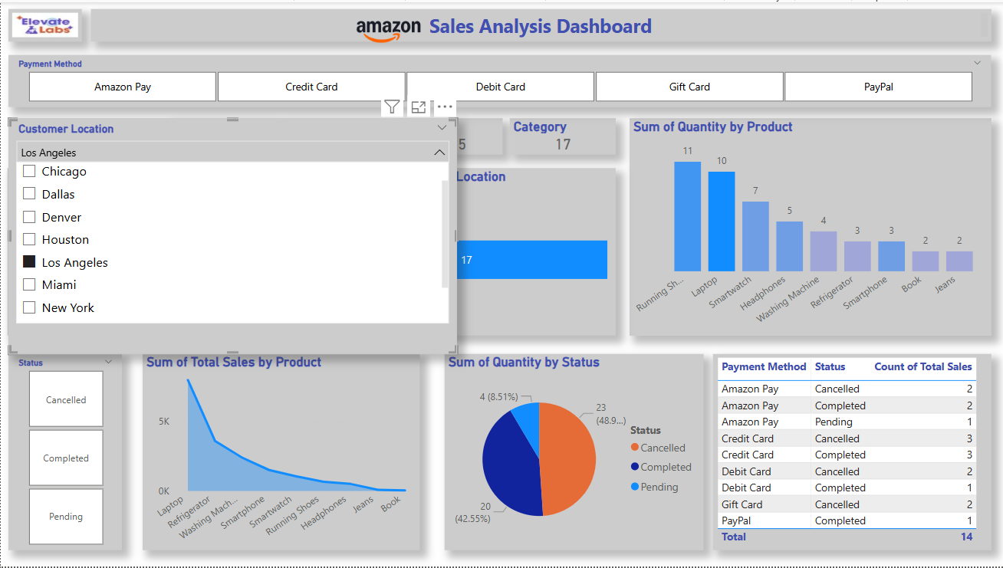
Based on customer’s location:

Slide 9
payment methods:
The dashboard includes a filter that allows users to view sales data based on
Various payment methods
Amazon pay
credit pay
debit pay
gift card
Pay pal
This enables a deeper understanding of customer performances and helps identify the most commonly used payment options throughout 2025

Slide 10
THANK YOU

